Slide 1
_{Morphology Review Slide Deck}
By Charlie wood

Slide 2
Insert prefix
Meaning/Function
Against or opposite
Example used in a sentence
The lonely man was antisocial
Words (5-10) containing the root/base
Antibiotic
Antidote
Anticipate
Anti abuse
Antiair

Slide 3

re
Do it again, back
I had to redo my homework because my dog ate it.
Redo
Replay
Reassign
Respect
Reschedule
Return

Slide 4
Insert root/base here
Insert Origin
Free/bound
Meaning/Function
Example used in a sentence
Words (5-10) containing the root/base

Slide 5
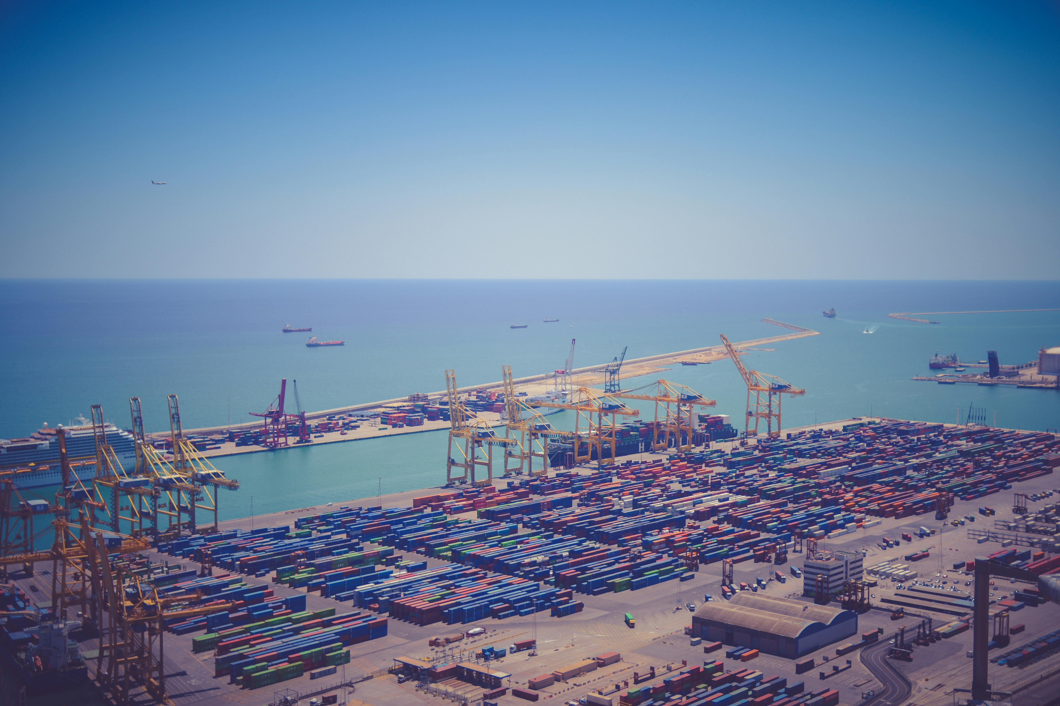
Port
Latin
Free and Bound
To carry
Many items purchased from Temu are imported from China.
Import
Export
Deport
Portable
Passport
Port
Airport

Slide 6
Insert suffix
Meaning/Function
Example used in a sentence
Words (5-10) containing the root/base

Slide 7
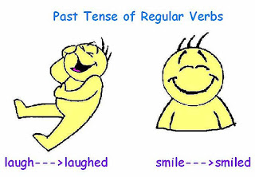
-ed
Past tense, already happened.
There was not toilet paper left as people when crazy and purchased it all before the cyclone hit.
Played
Purchased
Tuned
Talked
Dived
Scored
Rehearsed
This Photo by Unknown Author is licensed under CC BY-SA-NC

